Slide 1
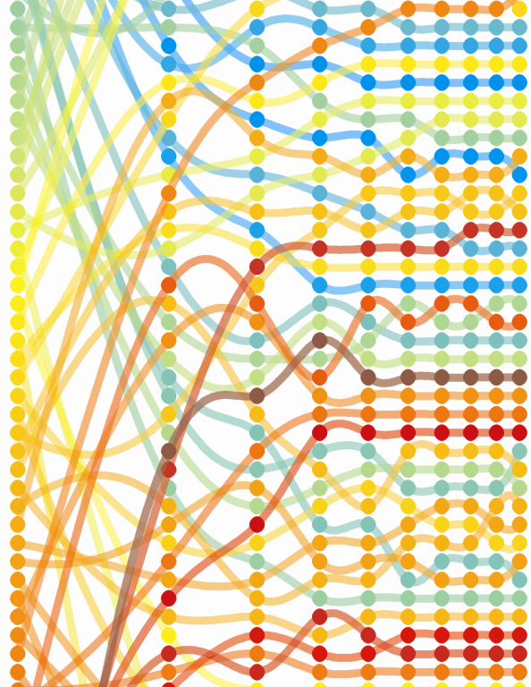
Measurements for many: A brief history on the co-evolution of data collection and statecraft.
Cesar A. Hidalgo
ABC Career Development Professor
MIT Media Lab
Faculty Associate, Center for International Development Harvard University

Slide 2
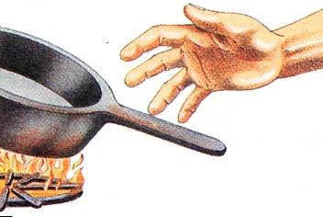
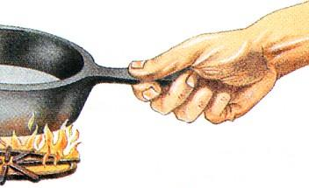
At our scale connecting observation to action is not a challenging problem
Our five senses are very good at “seeing” what is going on, and evolution has honed a large number of good responses into our biology.
There is little to no delay between measuring temperature and deciding to take your hand off the pan

Slide 3
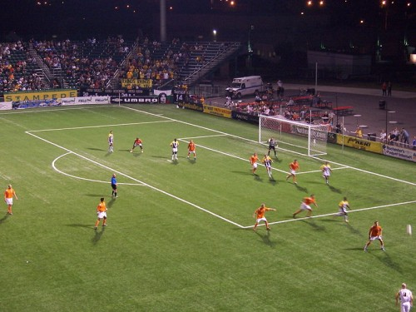
But it gets increasingly more complex as we start increasing the scale
Response?
STIMULUS

Slide 4
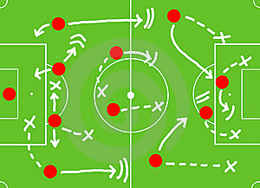
Predefine Rules of Action
Game plan or policy that assumes different possible scenarios and predefine responses
Predefined scenarios require a paramount effort in simplification:
Define a language to describe the system, make it legible
Define methods so the players can measure which state a system is at (create “maps”)
Define rules of action associated with each state
Provide mechanisms of coordination between the players so they can perform the predefined action

Slide 5
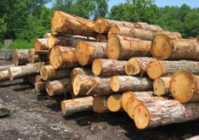
…It all started in 1765-1800 in Saxony and Prussia, as part of what was called cameral science “an effort to reduce the fiscal management of a kingdom to scientific principles”
Seeing like a state. James C Scott. Yale University Press (1997)

Slide 6
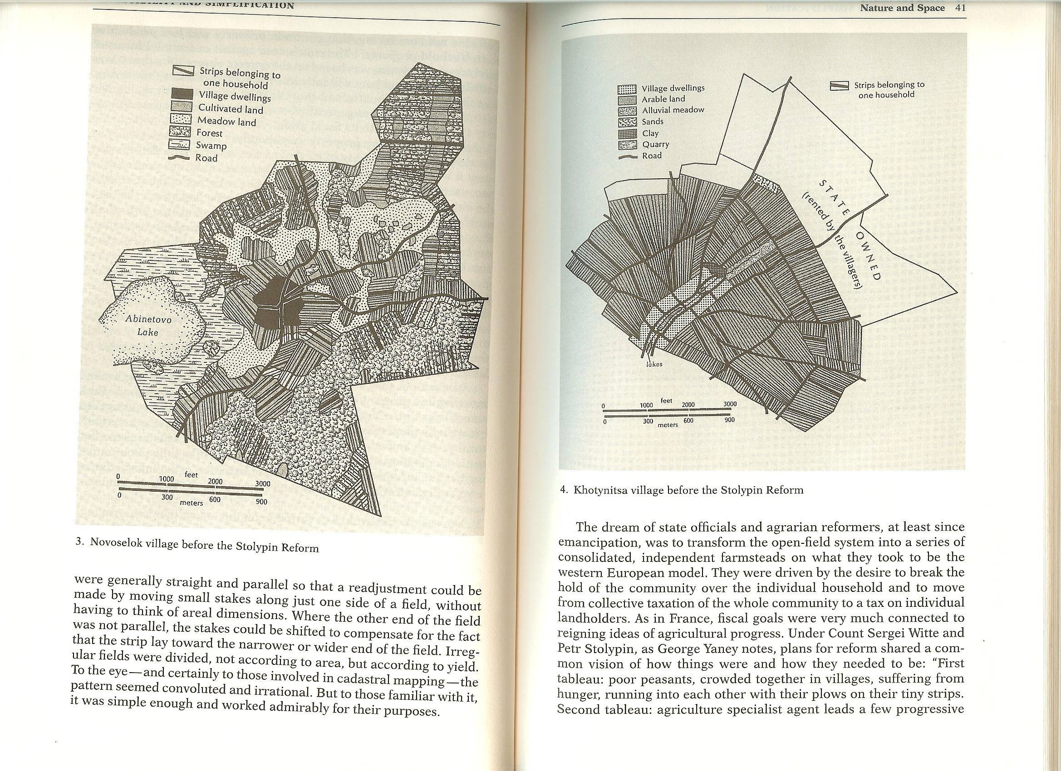
Making Society Legible (The creation of land property rights)
Seeing like a state. James C Scott. Yale University Press (1997)

Slide 7
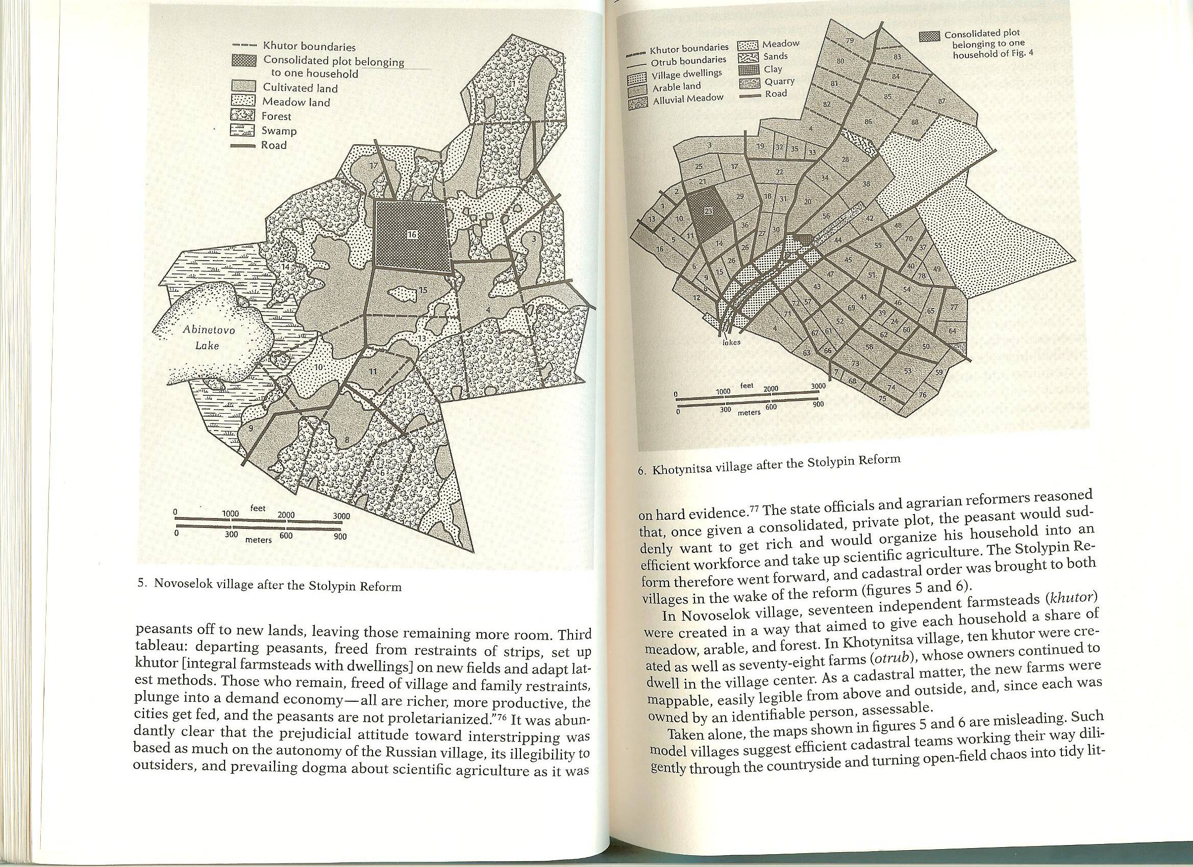
Making Society Legible (The creation of land property rights)
Seeing like a state. James C Scott. Yale University Press (1997)

Slide 8
Making Society Legible

Slide 9
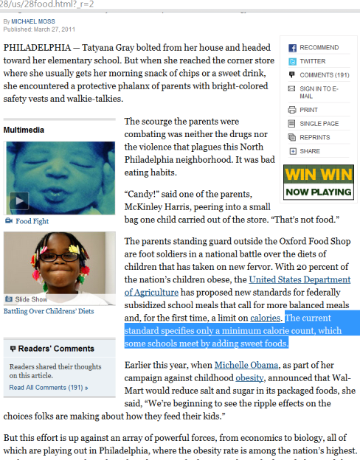
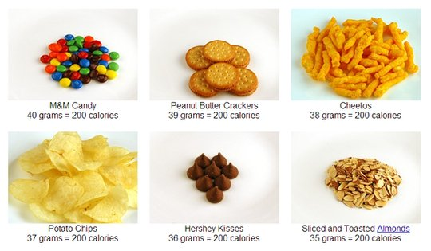
Two modern, yet popular, simplifications that are highly distortive

Slide 10
Making a complex system more legible is great
-It allows communication between its different parts
-It allows action at a distance
Making a complex system more legible has consequences
-It implies a paramount effort in simplifications, that narrows the policy makers field of vision and, promotes actions that make the system more compatible with its view

Slide 11
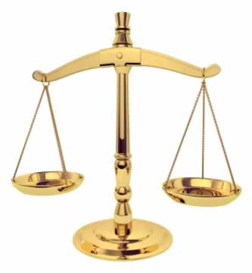
What make countries rich or poor?
Three Popular Answers
What People Know
How people govern themselves
The market conditions
EDUCATION:
GOVERNANCE:
COMPETITIVENESS:
Three Popular Measures
Years of Schooling
(a.k.a. ass in seat measure)
Standardized Test (PISA test)
(school quality)
World Governance
Indicators (World Bank)
-Political Stability
-Voice and Accountability
-Rule of Law
-Regulatory Quality
-Government Effectiveness
-Control of Corruption
Global Competiveness Index (World Economic Forum)
12 Pillars:
-Institutions
-Primary Education and Health
-Labor Market Efficiency
-Goods Market Efficiency
…
-Higher Education

Slide 12
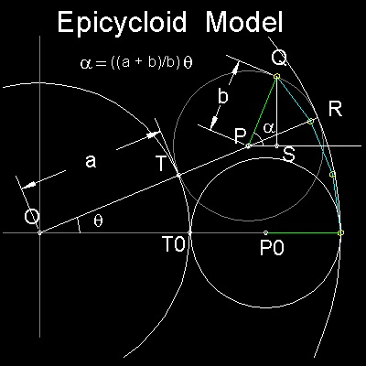

Slide 13
Hausmann, Hidalgo et al. Puritan Press (2011)

Slide 15
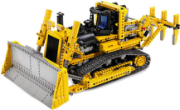
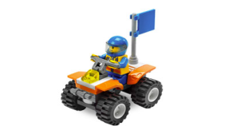
Capabilities and Products

Slide 16
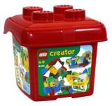
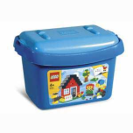
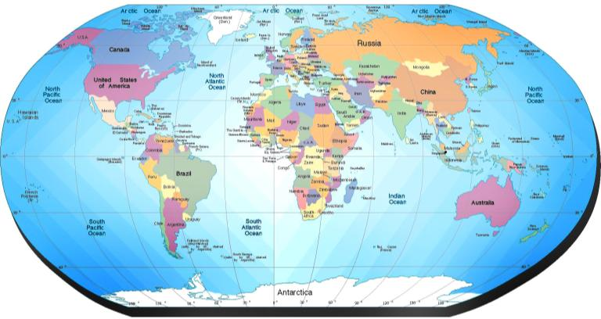
COUNTRIES and capabilities

Slide 17
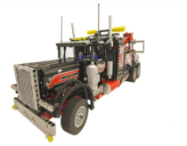
This Bi-Partite Observable
Countries
Products

Slide 18
The ROOT of the problem: connecting the structure of the observable network with the structure of its primitive components
C_{ca}
P_{pa}
M_{cp}
M_{cp}=1 if P_{pa} is a subset of C_{ca}

Slide 19
How about the reverse problem?
THOUGHT
WORLD

Slide 20
In Lego Language
In Network Language
(Simple) Few Capabilities
and
and
and
and
(Complex) Diverse Set of Capabilities
=
=
Hidalgo, Hausmann (2009) PNAS 106(26):10570-10575

Slide 21
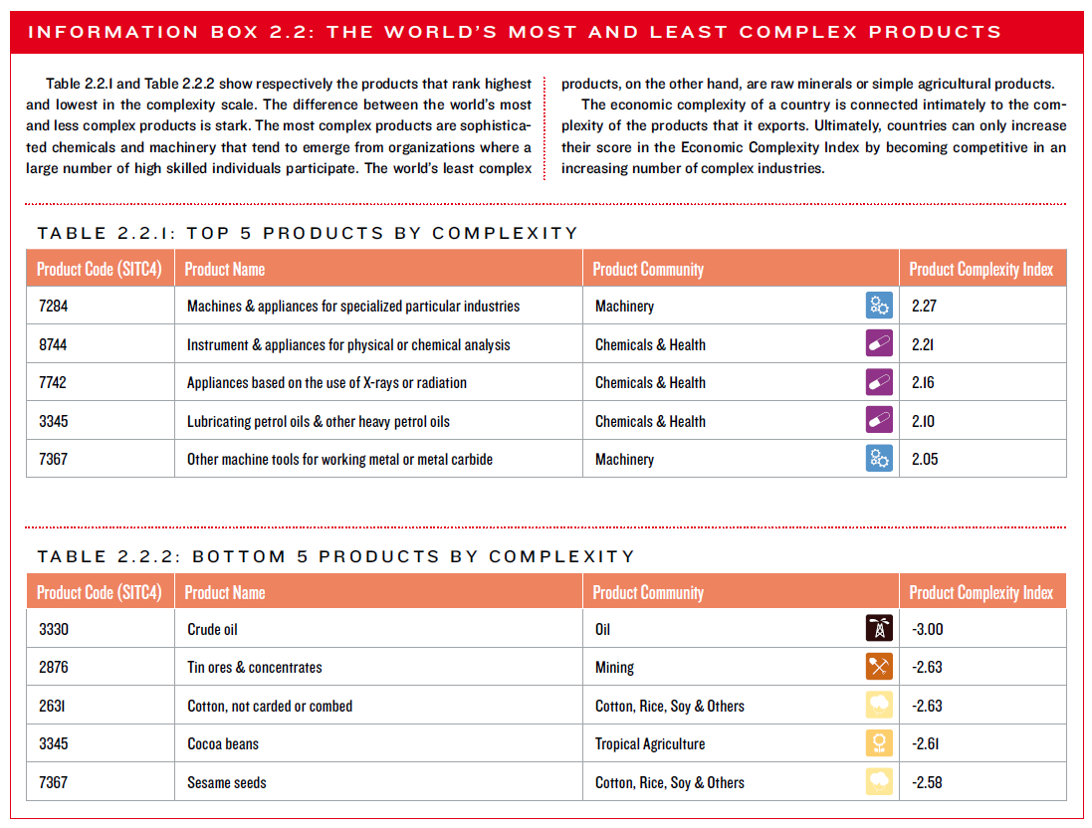

Slide 22
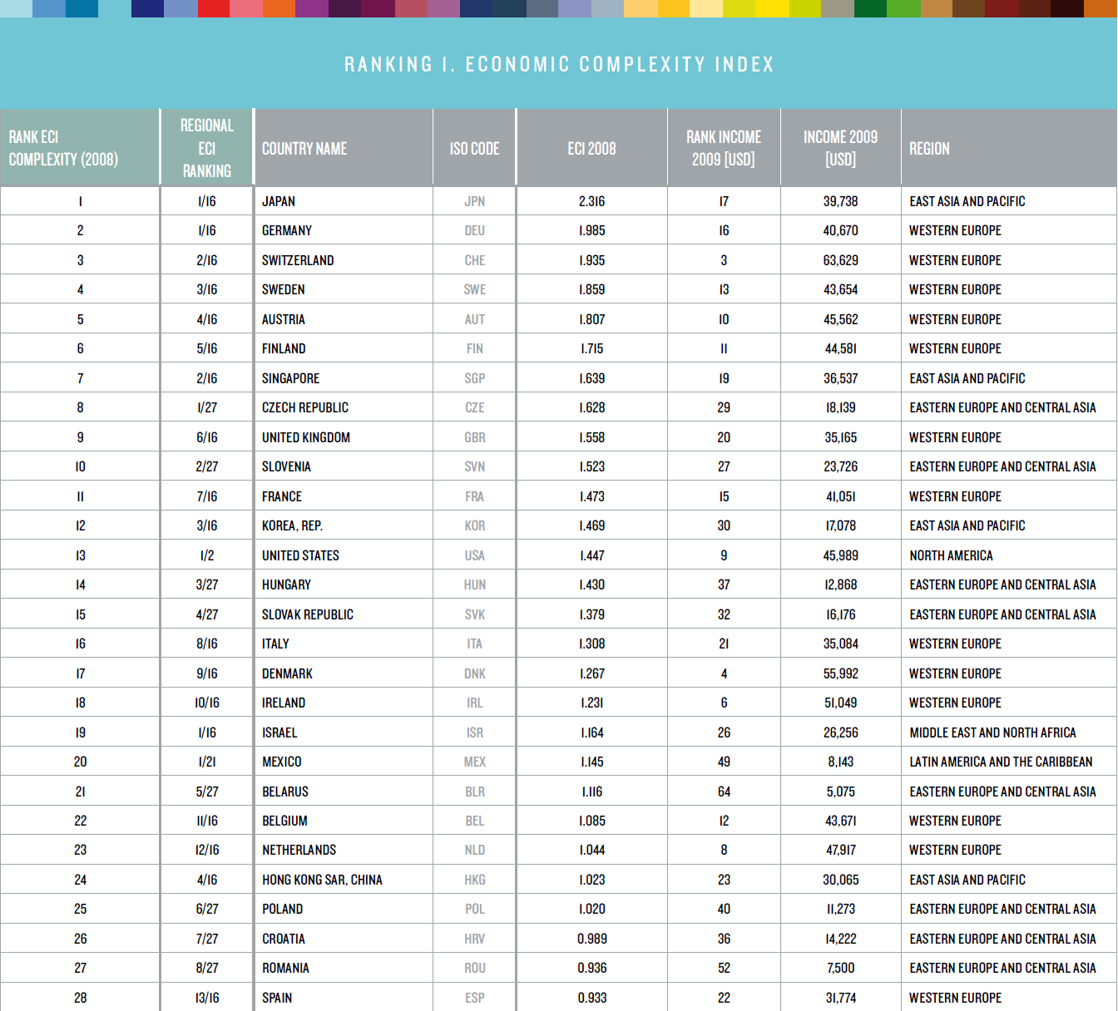

Slide 23
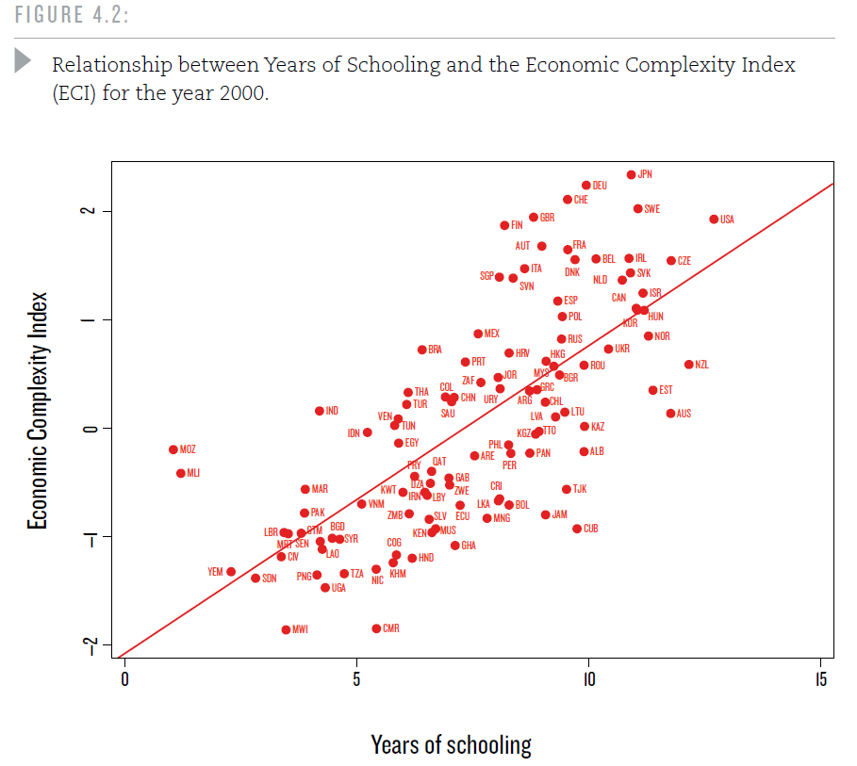

Slide 24
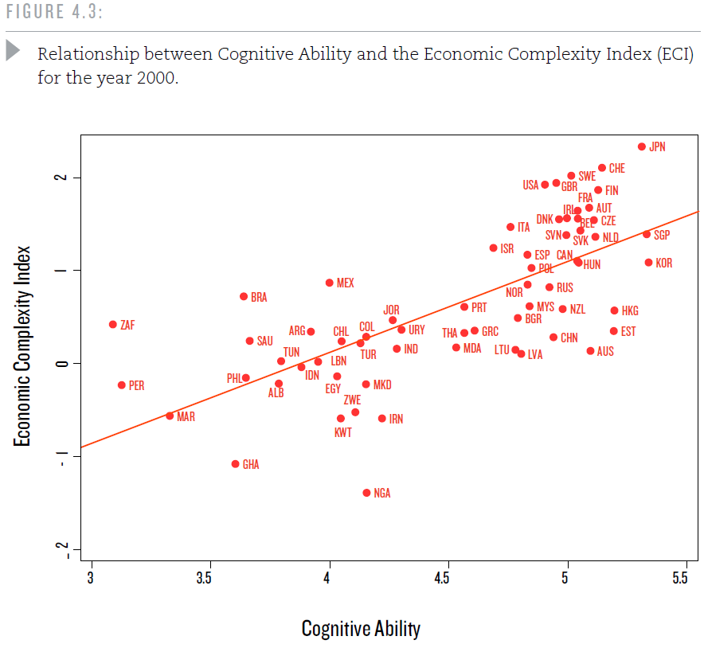

Slide 25
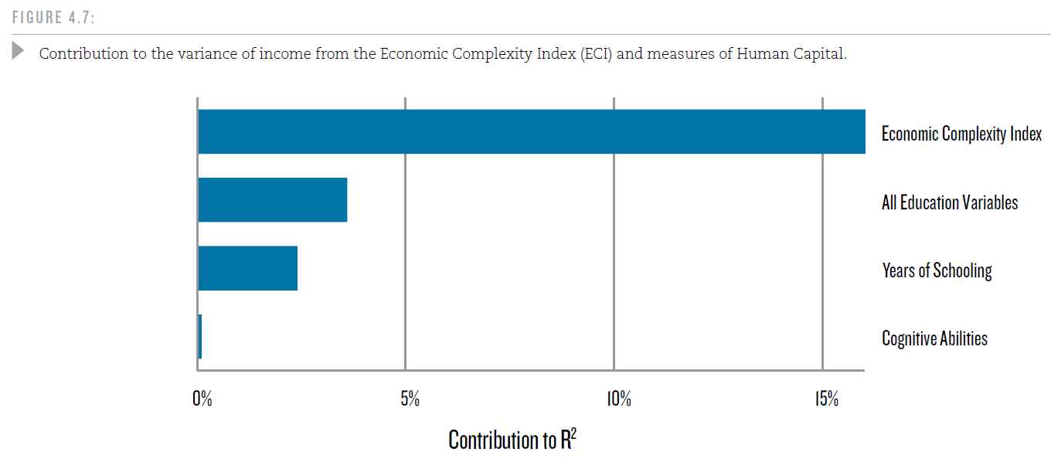
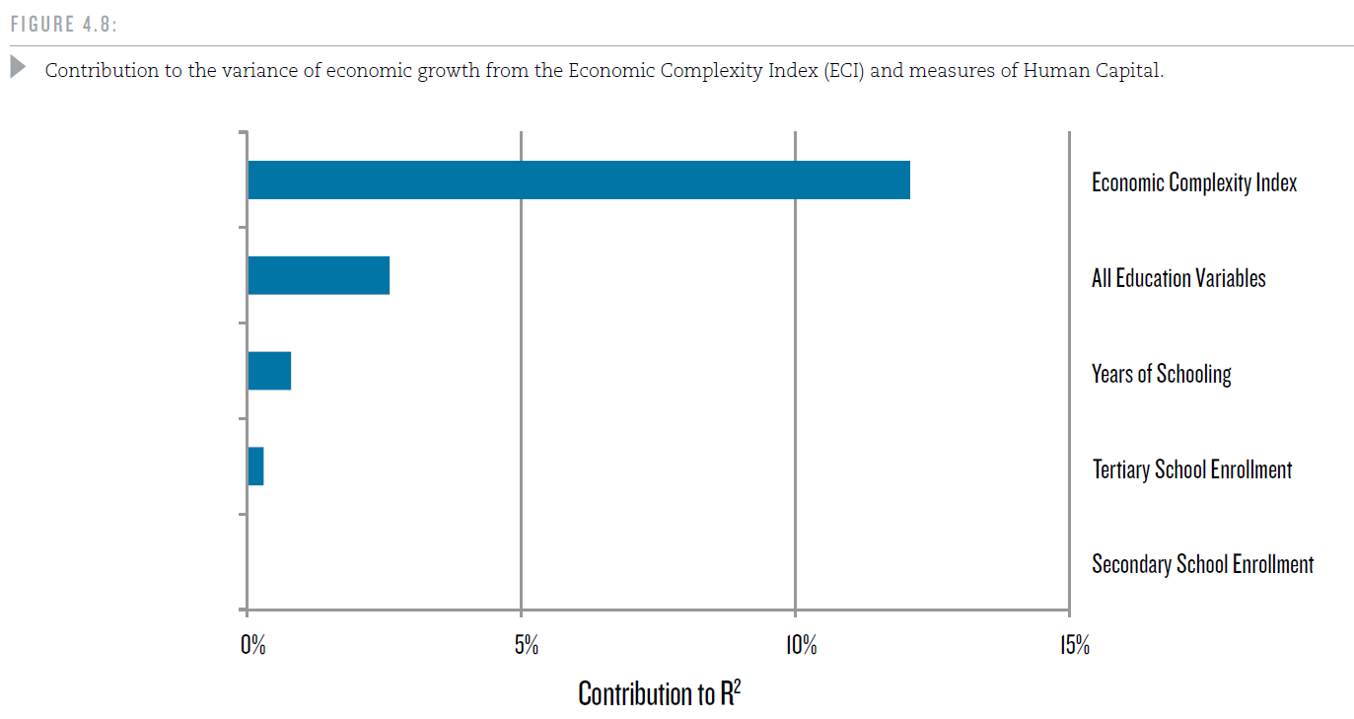

Slide 26
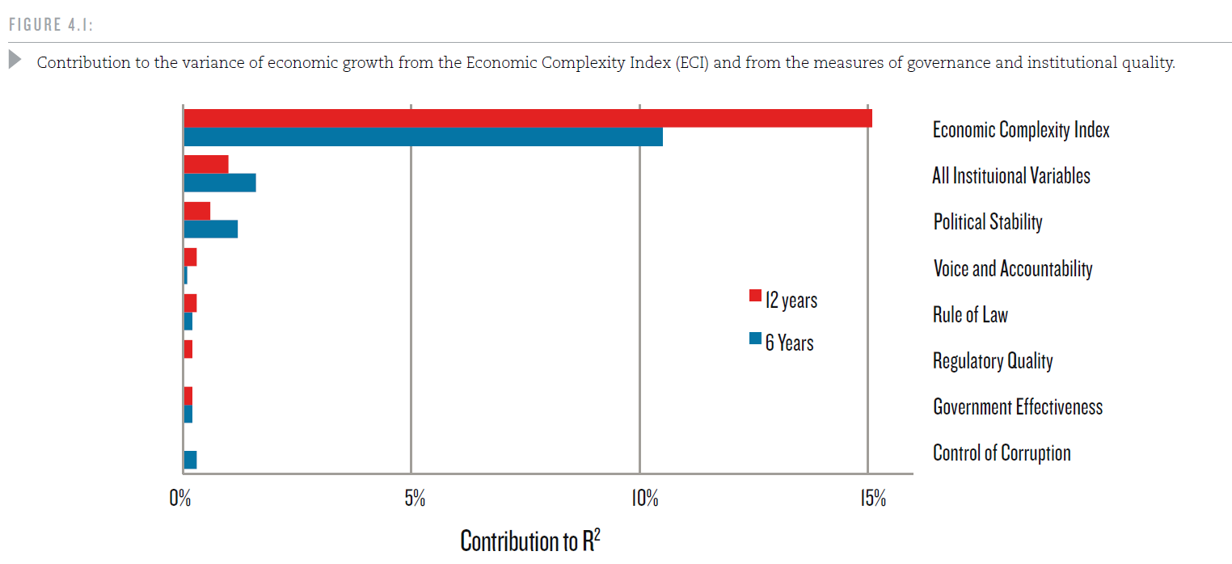
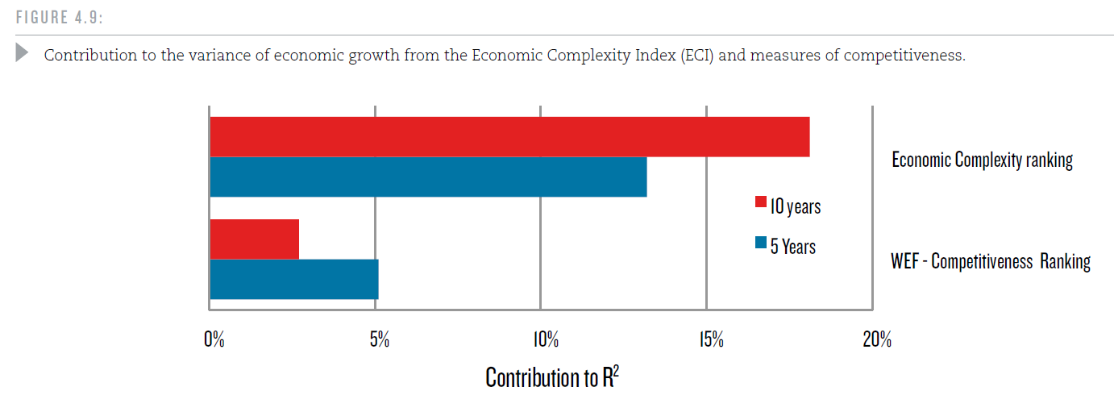

Slide 27
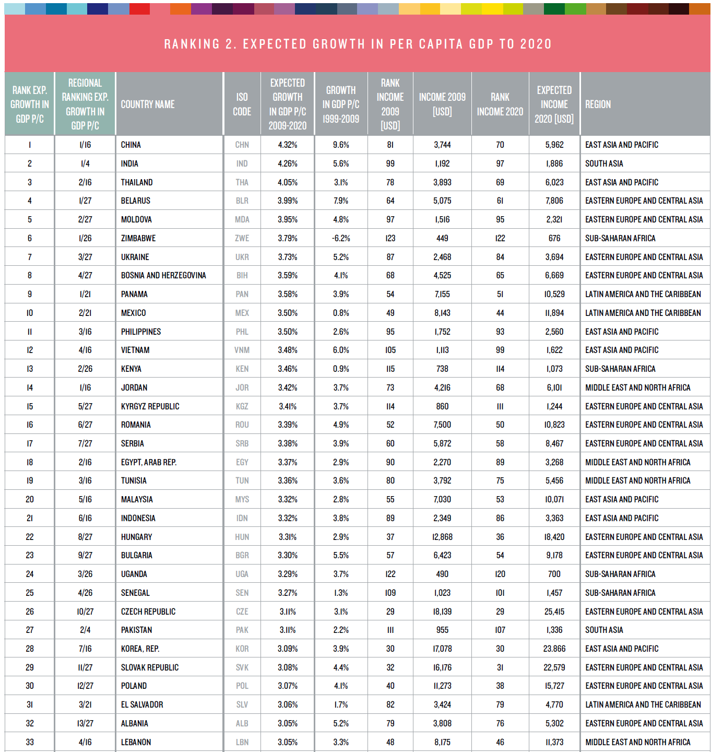

Slide 28
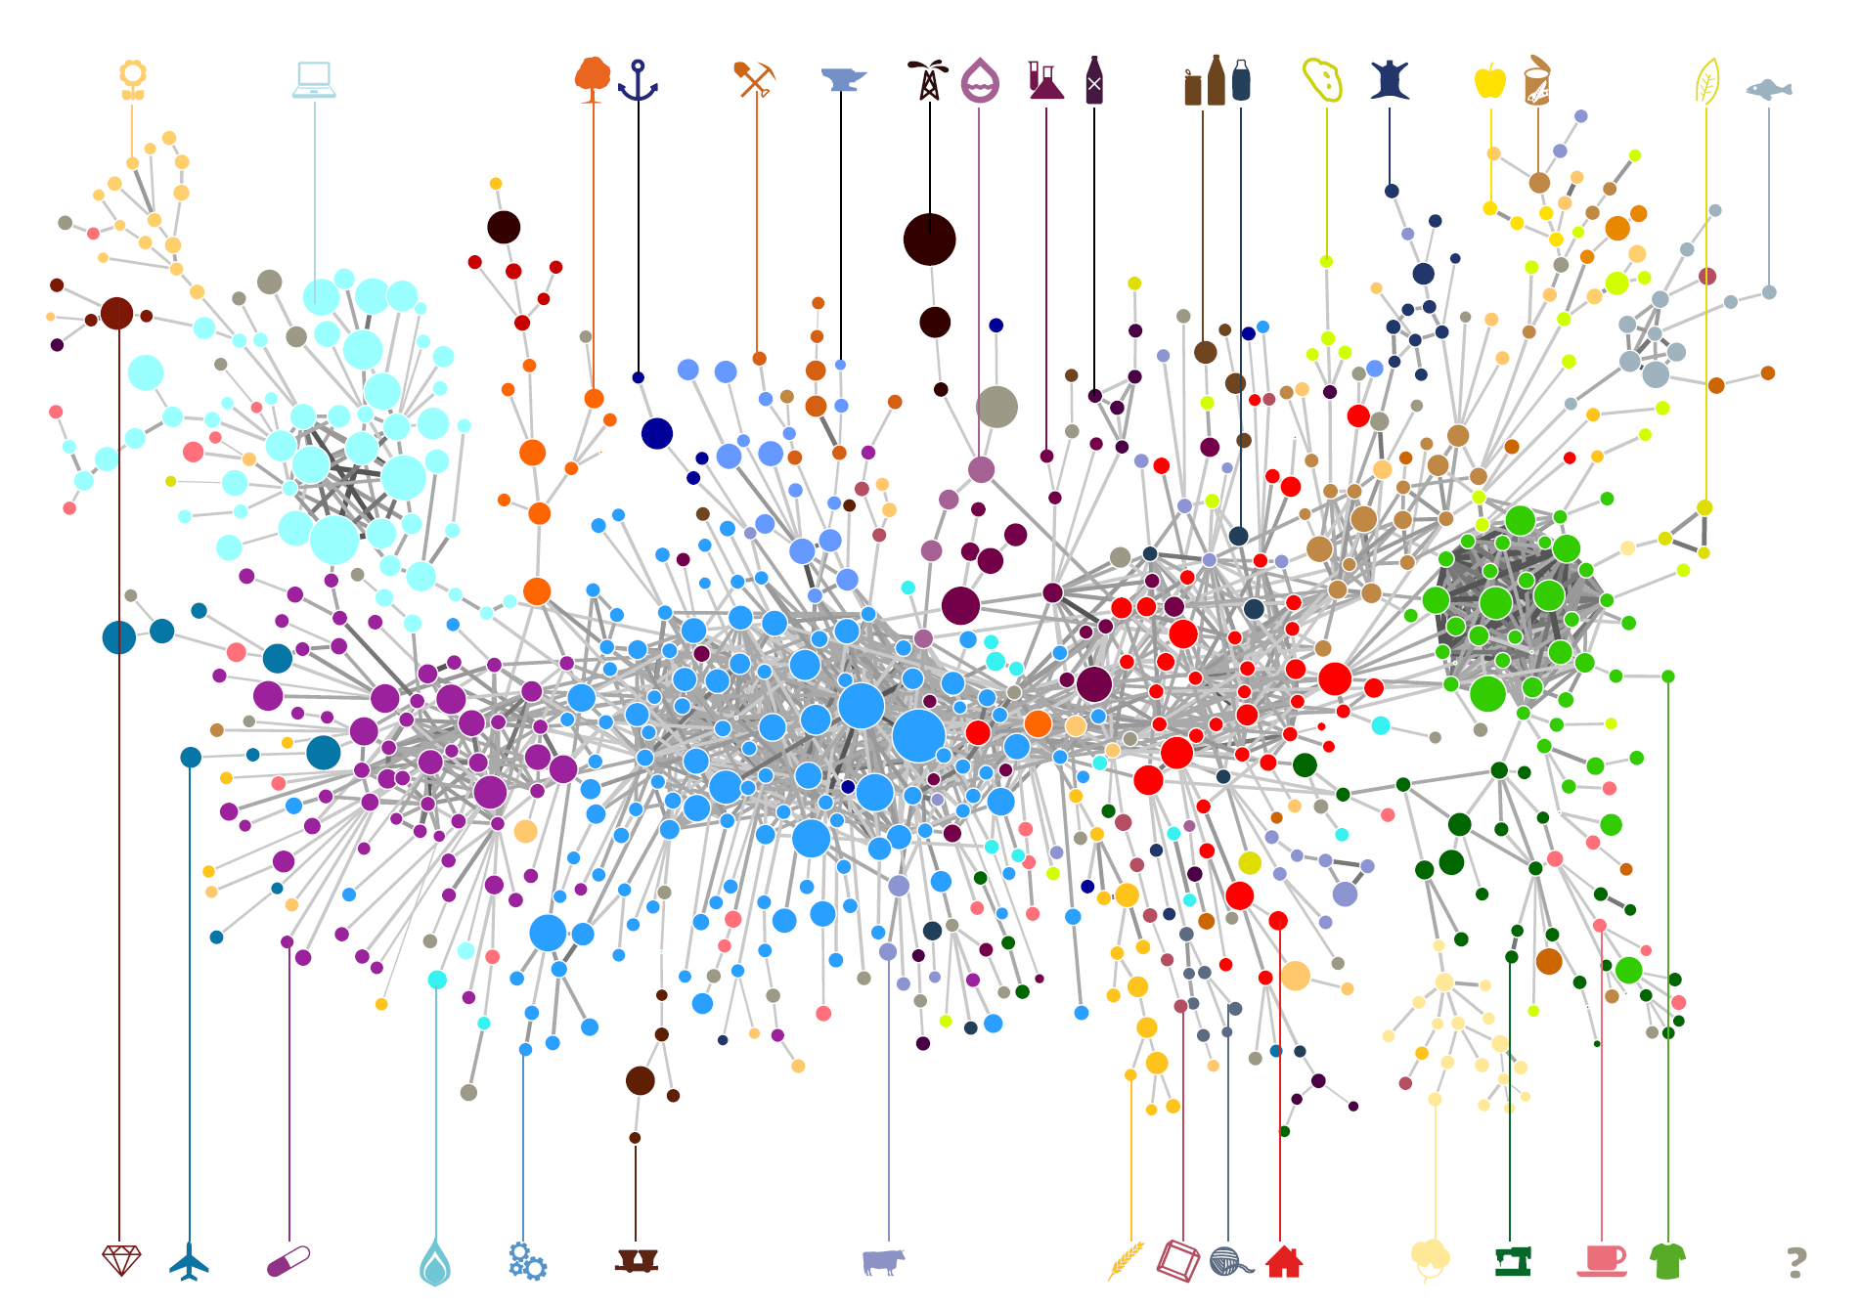
THE PRODUCT SPACE

Slide 29
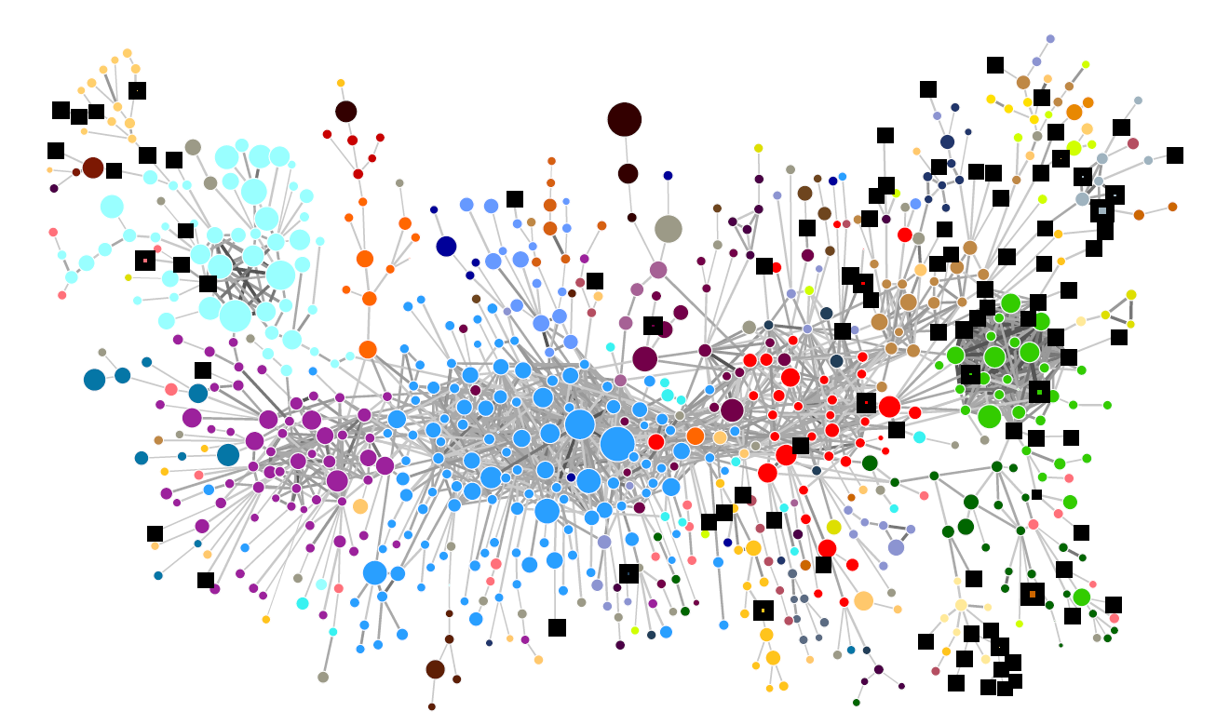
1975

Slide 30
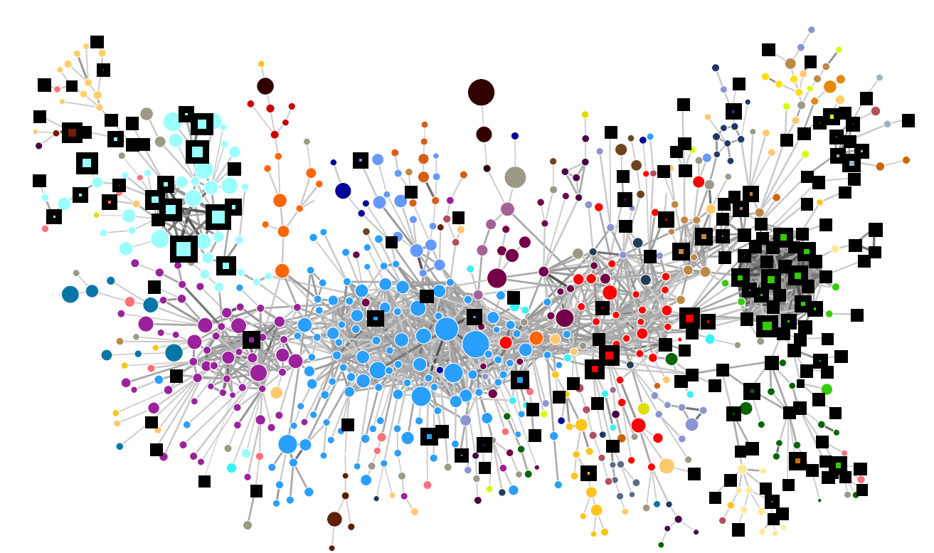
1990

Slide 31
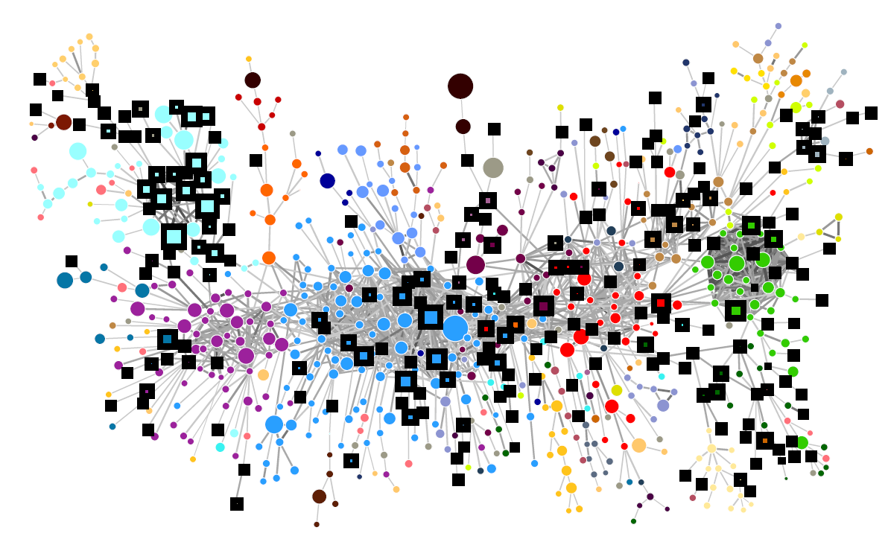
2009

Slide 32
CONCLUSION
States and large organizations need to act over complex systems. The management of these systems requires statistics and large volumes of data that are comprehensible to us only after grotesque simplifications.
These simplifications, however, are highly distortive and
tend to gear systems towards outcomes that are more
compatible with the measures of it, than with the outcomes
that inspired the measures in the first place.
Science can blind us. But it can also set us free. Here we show how a change in the language used to describe a system can provide novel solutions and observables that allow a deeper understanding, and more accurate predictions.
One of the goals of communication is to generate languages that are adequate to describe specific problems. Systems that cannot be understood from one perspective are perfectly clear when a new language is adopted. This puts communication at the forefront of our search for deeper understanding.

